Slide 1

Nutrition

Slide 3
Nutrition Mathematics: BMI
BMI = weight (kg) ÷ height² (m²)
  Underweight: <18.5
  Normal: 18.5–24.9
  Overweight: 25–29.9
  Obese: ≥30
Caloric needs: 25–35 kcal/kg/day general
  May need more if critically ill
Protein needs: 0.8–1.0 g/kg/day general
  May need more if critically ill or healing a wound
Notes:
CLINICAL NOTE: BMI is a screening tool, not a direct measure of body fat. It may overestimate body fat in very muscular individuals and underestimate in elderly clients with muscle wasting. Always combine BMI with clinical assessment.

Slide 4

Diets
Nothing by mouth (NPO)
Regular
Soft
Pureed
Full liquid
Clear liquid
Notes:
Depending on a client’s health, eating, chewing, and swallowing abilities, a specific diet geared toward meeting any deficits may be required.
NPO diets can be prescribed for various reasons. An NPO diet restricts the client from eating or drinking anything until the diet is advanced. Such a diet may be prescribed due to the client’s inability to safely eat and drink, a scheduled surgery, or an upcoming diagnostic test that requires fasting or for the stomach and intestines to be empty. Nurses should clarify with the provider if the NPO status extends to medications as well. Maintaining NPO status prior to surgery or procedures helps to protect the client from aspirating while under sedation.
Regular – consists of any food, ideally a mixture from all food groups. A client eating a regular diet should also have no issues with chewing and swallowing, as all foods are allowed. The nurse should help guide the client in making healthy food choices
Soft – foods that are soft and easy to digest, swallow, and that are low in fiber. This type of diet can be maintained for the short or long term, depending on the client’s medical condition. A soft diet may be prescribed for clients recovering from surgeries on particular areas or if having swallowing difficulties. Soft diets include foods that are bland such as well-cooked vegetables, low-fiber cereals, and easy-to-chew proteins (e.g. tender meat, fish). Examples include baked goods (e.g. bread, pancakes), fruit juices without pulp, tender cuts of beef, creamy peanut butter, and cooked fruit without the skin or seeds.
Pureed – foods that do not need to be chewed. Foods that can be eaten on a pureed diet include pudding, mashed potatoes, yogurt, juices without pulp, baby food, pureed meats, broths, and ice cream.
Full – fluids only, foods that are liquid at room temp such as ice cream. Other examples include juices, pudding, milkshakes, tea, strained soups, popsicles and Jell-O. Solid foods are not allowed on a full liquid diet. This diet may be prescribed if a client is postoperative from abdominal surgery, is experiencing dysphagia, or prior to undergoing certain procedures.
Clear – clear liquids only. broth, gelatin, and water. Foods that can be seen through, such as gelatin, can be included on a clear liquid diet, as well as foods that partly or completely melt at room temperature. Other acceptable foods include tea, fruit juices without pulp, and sports drinks. In essence, this diet consists of easily digestible foods that do not leave undigested residue in the intestinal tract. It is intended to decrease the strain on the digestive system while keeping the body adequately hydrated. Solid foods should not be eaten while on a clear liquid diet. A clear liquid diet may be required before or after certain procedures, following surgery, or due to digestive issues. It should be restricted to no more than a few days due to the limited amount of calories and nutrients that it offers. Liquids or gelatin with red coloring need to be avoided for colon procedures and tonsillectomies to avoid any confusion with possible bleeding. A clear liquid diet is also appropriate for clients who are experiencing nausea, vomiting, and diarrhea.

Slide 5
Special Diets and Cultural Considerations
Low sodium (<2 g/day): heart failure, hypertension, CKD, cirrhosis
Renal diet: restrict potassium, phosphorus, sodium, protein, fluid;
Diabetic diet: consistent carbs 45–60 g/meal; coordinate meals with insulin
Respect cultural/religious practices:
  Kosher, Halal, Hindu, vegetarian, and others
Never force dietary compliance
  Educate and discuss
  Document any refusals
  Notify dietician and provider
Notes:
THERAPEUTIC DIET REFERENCE:
Low sodium (<2 g/day): heart failure, hypertension, CKD, cirrhosis, edema. Avoid canned goods, processed foods, soy sauce, smoked meats. Monitor BP, edema, daily weight.
Low cholesterol/cardiac: CAD, post-MI, hyperlipidemia. Limit saturated fat <7% of total calories; avoid trans fats. Encourage plant sterols and omega-3s.
High protein (1.2-2.0 g/kg): wound healing, burns, malnutrition, nephrotic syndrome. CONTRAINDICATED in renal failure (use renal formula instead).
Renal diet (CKD/ESRD/hemodialysis): restrict K+, phosphorus, sodium, protein, and fluid. No salt substitutes (high K+). Review labs before meals. Refer to renal dietitian.
Diabetic/carb-controlled: consistent 45-60 g carbohydrate per meal. Avoid concentrated sweets. Coordinate meal timing with insulin administration.
Low-residue/low-fiber (<10-15 g/day): Crohn's flare, colostomy, diverticulitis (acute), bowel prep. Ensure adequate hydration.
High fiber (>25-35 g/day): constipation, IBS, diverticulosis (chronic), cardiovascular prevention. Introduce gradually with increased fluid to prevent gas.
CULTURAL/RELIGIOUS DIETARY PRACTICES (all self-reported by client): Kosher - meat and dairy not mixed; pork and shellfish avoided. Halal - pork and alcohol prohibited; Ramadan fasting (illness may exempt). Hindu - many avoid beef; some vegetarian. Buddhist - some sects vegetarian or avoid garlic/onion. Seventh-Day Adventist - many vegetarian; avoid caffeine and alcohol. Lactose intolerance - very common in Asian, African, and Hispanic populations.
NURSING PRINCIPLE: Never force dietary compliance. Educate and discuss. Document refusals and notify dietitian and provider. Involve client in planning to improve adherence.

Slide 6
Calorie Counts
Systematic record of all oral intake to evaluate nutritional adequacy
Document every meal and snack: item, portion size, and % consumed
  Can add note with exactly what was eaten along with percent
Include all liquids, supplements, and ice chips
Provides overview of client’s nutrition each day
  Useful when weaning off enteral nutrition
Notes:
CALORIE COUNT PROCESS:
Obtain a provider order or initiate per facility protocol (typically by RN or registered dietitian). Educate the client and family that ALL intake must be recorded - including between-meal snacks, water, broth, and supplements.
Record at every meal and snack: food item, portion offered, portion consumed, and percentage eaten. Use a standardized calorie count form per facility policy.
Calculate daily caloric and protein intake using nutrient reference values or software. Reporting is typically done by the nursing team to the registered dietitian.
If a client consistently eats less than 50-75% of meals, this triggers reassessment and dietitian referral. Never document 'good' or 'poor' - always use percentages.

Slide 7
Nutritional Supplements
Use between meals to increase total intake; not as meal replacements
Standard (Ensure Plus, Boost Plus): general malnutrition, weight loss
Renal formula (Nepro): low K+/phosphorus — do NOT use standard Ensure in end stage renal disease
Diabetic formula (Glucerna): slower carbohydrate absorption
Document supplement intake as part of calorie count
Notes:
SUPPLEMENT SELECTION GUIDE:
Complete oral supplement (Ensure Plus, Boost Plus, Carnation Breakfast Essentials): high calorie and protein. Indications: malnutrition risk, unintentional weight loss, cancer, post-op. Serve chilled to improve palatability.
Clear liquid supplement (Ensure Clear, Boost Breeze): appropriate for thin liquid dysphagia diet or pre-procedure. Lower protein and calorie content than standard formulas.
Renal-specific formula (Nepro, Renalcal, Novasource Renal): low potassium, phosphorus, and fluid content. Use ONLY for CKD/ESRD/dialysis patients. Never substitute standard Ensure - the protein content is too high for renal clients.
Diabetic formula (Glucerna): slower carbohydrate absorption reduces post-prandial glucose spikes. Monitor blood glucose response.
Immunomodulating supplement (Juven, Impact, ProSure): contains arginine, glutamine, omega-3s. Indications: wound healing, surgical stress, cancer cachexia. Use per dietitian recommendation.
Protein powder/modular (Beneprotein whey protein, ProMod): adds protein without significantly increasing volume or calories. Can be mixed into food or beverages. Always verify renal function before using protein supplements.
NURSING CONSIDERATIONS: Monitor tolerance - GI upset, diarrhea, and bloating can occur with high-osmolality formulas. Document supplement intake as part of calorie count records. Reassess effectiveness by tracking weight trends and labs (albumin, prealbumin).

Slide 8
Monitoring Client Hydration Status
Assess for dehydration
  dry mucous membranes, decreased skin turgor, dark urine
Severe dehydration
  tachycardia, hypotension, urine output <30 mL/hr (oliguria)
Fluid overload
  peripheral edema, crackles, JVD, weight gain >1 kg/day
Monitor I&O, daily weights, and labs (BUN, creatinine, sodium, potassium)
Notify provider
  urine output <30 mL/hr or signs of fluid overload
Notes:
DEHYDRATION - ASSESSMENT DETAILS:
Mild-moderate: thirst, dry mouth, dark amber urine, headache, fatigue, decreased skin turgor (tenting test), sunken eyes, weight loss 1-5%.
Severe: tachycardia, hypotension, no/minimal urine output, altered mental status, cool mottled skin, capillary refill >3 seconds, weight loss >5%.
OVERHYDRATION / FLUID OVERLOAD - ASSESSMENT DETAILS:
Peripheral edema: press over bony prominence (dorsum of foot, ankle, tibia) for 5 seconds. Grade: 1+ (mild, 2mm) to 4+ (severe, >8mm, does not rebound).
Pulmonary edema signs: crackles on auscultation, orthopnea (difficulty breathing lying flat), frothy pink sputum. NOTIFY PROVIDER IMMEDIATELY.
Jugular venous distension (JVD): visible neck vein engorgement with head of bed elevated 45 degrees indicates right-sided fluid overload.
NORMAL REFERENCES: Daily fluid requirement: ~30 mL/kg/day. Insensible losses: ~600-900 mL/day. Minimum urine output: 30 mL/hr (0.5 mL/kg/hr). Normal urine specific gravity: 1.005-1.030.
NURSING INTERVENTIONS: Increase oral fluids if safe; administer IV fluids per order. Monitor I&O every 1-8 hours per acuity. Weigh daily (same time, same scale). Monitor labs. Restrict fluids per order if overloaded.

Slide 9
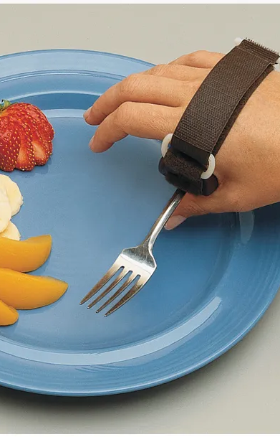
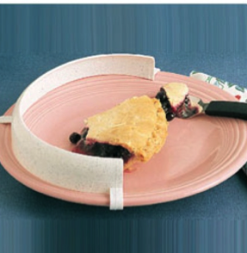
Nurses Role with Eating/Feeding
Ensure clients receive the assistance they need
Nurse must assess client’s ability to safely swallow before delegating feeding
Promote independence
Client may require assistive devices

Slide 10
Dysphagia and Aspiration
Dysphagia
Difficulty swallowing
Signs:
  Coughing while eating
  Change in voice tone after swallowing
  Abnormal tongue/mouth movements
  Incomplete oral clearance
  Regurgitation
Caused by various reasons including stroke, age, muscular dystrophy, multiple sclerosis
Swallow study
Occurs when something other than air enters the lung
Prone to happening if client has dysphagia
Silent aspiration
  No obvious symptoms
Diet modifications help prevent aspiration

Slide 11
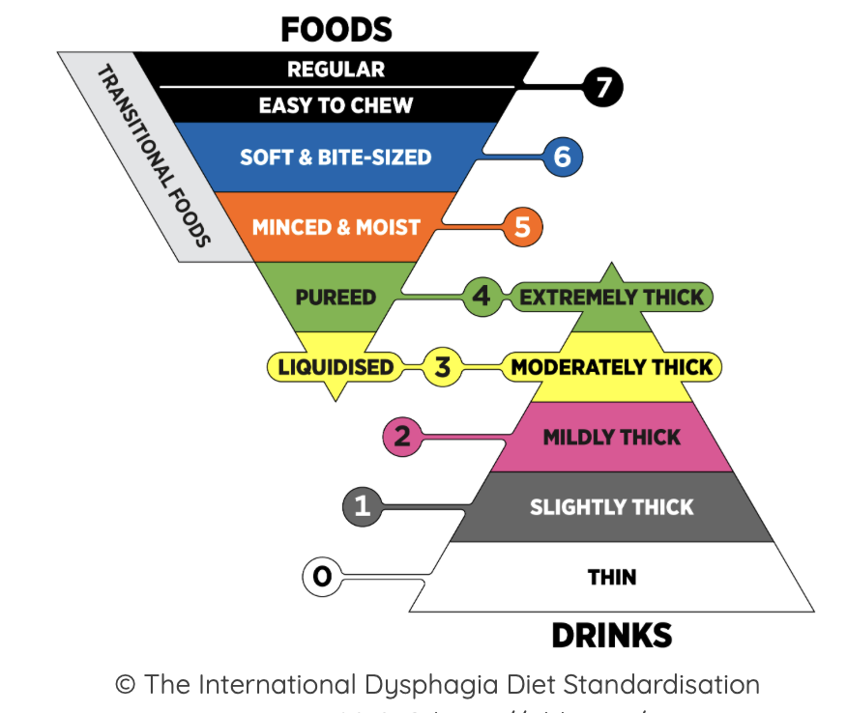
Speech Therapy/Swallow Studies
Consult speech therapy when concerns of dysphagia or aspiration are noted
Speech therapist will conduct swallow study
  Observe client swallowing small amount of liquid
  Goal is to determine safest type of liquids to allow with aspiration
The International Dysphagia Diet Standardization Initiative (IDDSI) is the current standard framework used in most hospitals.
Notes:
© The International Dysphagia Diet Standardisation Initiative 2019 @ https://iddsi.org/ Licensed under the CreativeCommons Attribution Sharealike 4.0 License https://creativecommons.org/licenses/by-sa/4.0/legalcode. Derivative works extending beyond language translation are NOT PERMITTED.

Slide 12
Nurse’s Roll after Evaluation
Implement the prescribed diet and liquid level
  never downgrade or upgrade without an order
Ensure ALL staff (CNAs, dietary, family) are aware of the thickening requirement
Sit patient upright (90°) for all meals and liquids
  maintain position 30–60 min after eating
Monitor for silent aspiration
  no cough, but O2 drops, recurrent pneumonia, wet voice
Document intake, tolerance, and any signs of aspiration each meal
Educate family
  a well-meaning family member bringing a milkshake to a Level 3 patient is a real safety risk

Slide 13
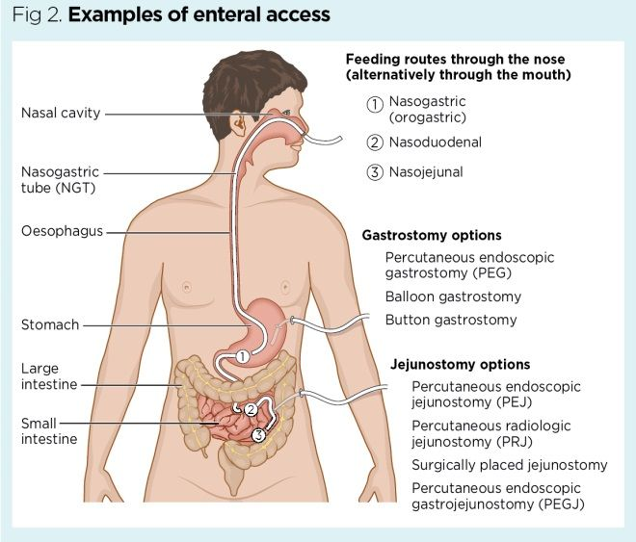
Enteral Nutrition
Enteral nutrition is nutritional intake through the gastrointestinal tract.
Check placement before feedings
Start feedings slowly
Elevate head of bed to decrease aspiration risk
Check gastric residual volumes
Monitor for complications:
  Dehydration
  Diarrhea
  Hyperglycemia
  Tube occlusion
  Refeeding syndrome
Notes:
A gastrostomy tube (G-tube) is a tube that delivers nutrition directly into the stomach. It is inserted through the abdomen and is indicated for clients who are unable to consume enough nutrition on their own. The placement of a G-tube is performed by a surgeon.
A nasogastric (NG) tube is a thin plastic tube that is inserted into the nostril and down the esophagus, with the end placed in the stomach. It is primarily used to provide nutrition and medication to a client, but can also be used to remove contents from the stomach in the event of a client ingesting a harmful substance, poison, or too much medication. The removal of stomach contents is facilitated by attaching the NG tube to suction. Placement of the NG tube must be verified by x-ray prior to its use. The tube is taped to the client’s nose to secure it.
Enteral feedings are prescribed for clients who do not have adequate oral intake or nutrition that can meet their metabolic needs. Such feedings are often used for clients who cannot eat safely due to swallowing impairments or dysphagia. Tube feedings can provide a client’s total sustenance, or they can be used to supplement the diet.
Enteral nutrition has been associated with improved nutrition, lower incidence of infection, and decreased days in the hospital. It is the preferred mode of feeding versus parenteral nutrition.
Refeeding syndrome: Occurs with rapid introduction of nutrition after prolonged starvation/malnutrition. Causes dangerous hypophosphatemia, hypokalemia, hypomagnesemia, and potentially fatal cardiac arrhythmias. Prevention: start tube feedings SLOWLY; monitor electrolytes (especially phosphorus, potassium, magnesium) before and during feeds; correct deficiencies before starting feeds.
TUBE OCCLUSION: Flush tube with 30 mL water before and after medications and every 4-8 hours during continuous feedings. Never force flush an occluded tube. Warm water flushes may help; consult dietitian or pharmacy if persistent.

Slide 14
Parenteral Nutrition
Parenteral nutrition is given intravenously through a large vein to clients whose GI system doesn’t function appropriately (they are at risk for malnutrition).
Administered to clients to cannot digest or absorb enteral nutrition
Goal is to move from parental to enteral to oral nutrition
Must give through a large vein – usually central line
  Peripheral parental nutrition (PPN)
    Can be give through IV
Notes:
Parenteral nutrition can prevent malnutrition by replacing missing nutrients that would be otherwise consumed with eating.
Clients with a digestive system that cannot absorb or tolerate adequate food eaten by mouth can utilize parenteral nutrition.
Parenteral nutrition, in the form of IV fluid, is administered into a large vein through a venous access device. The provider can customize the nutrition provided for a client according to their specific nutritional requirements and relevant laboratory results such as electrolytes, blood glucose, mineral levels, renal and liver function test.
For clients without a functioning GI tract, total parenteral nutrition may be the only option. A complication of total parenteral nutrition is abnormalities in glucose, including high blood glucose. To monitor for this possibility, frequent blood glucose checks should be completed per the provider’s prescription.

Slide 15
Food-Medication Interactions
Certain foods alter drug absorption, metabolism, or efficacy
  Grapefruit juice + statins/Calcium Channel Blockers → toxicity risk
  Vitamin K foods (leafy greens) + Warfarin → reduced anticoagulant effect
  Tyramine foods + MAOIs → life-threatening hypertensive crisis
    Tyramine increases in foods as they ferment or spoil
      Avoid aged cheeses, processed meats, overripe/dried fruits
Assess medications, diet, and supplements at every admission
Notes:
FOOD-DRUG INTERACTION DETAILS:
Grapefruit juice inhibits the CYP3A4 enzyme in the gut wall, increasing blood levels of statins, calcium channel blockers, and some immunosuppressants. Instruct clients to avoid grapefruit juice with these medications.
Vitamin K-rich foods (spinach, kale, broccoli, Brussels sprouts) antagonize Warfarin. Teach consistent intake rather than elimination; monitor INR and report dietary changes to the provider.
Tyramine-rich foods (aged cheese, cured meats, red wine, soy sauce) with MAOIs can cause a potentially fatal hypertensive crisis. Provide strict dietary education before starting MAOIs.
Dairy/calcium chelates tetracyclines and fluoroquinolones (e.g., ciprofloxacin), reducing absorption. Separate dose by 1-2 hours before or 4-6 hours after dairy.
Salt substitutes are high in potassium. Avoid with ACE inhibitors or potassium-sparing diuretics due to hyperkalemia risk.
Alcohol interacts with metronidazole (disulfiram-like reaction), metformin (lactic acidosis risk), and acetaminophen (hepatotoxicity). Screen for alcohol use routinely.
NURSING ACTIONS: Obtain complete medication and herbal supplement history at admission. Consult pharmacist or dietitian for complex interactions. Document and communicate all dietary restrictions in the care plan. Educate client and reinforce before discharge.

Slide 16
Impact of Disease on Nutritional Status
Disease can alter metabolism, absorption, appetite, and nutrient requirements
Examples:
  Chronic Kidney Disease: restrict protein, potassium, phosphorus, & salt
  Heart failure: low-sodium diet; strict I&O and daily weights
  Diabetes: impact of hyperglycemia, coordinate meals with insulin, consistent carbs
  Cancer/chemo: high calorie/protein; address nausea, consider mucositis and changes in taste
Always refer to registered dietitian for disease-specific nutrition planning
Notes:
CHRONIC KIDNEY DISEASE (CKD): Impaired protein metabolism; accumulation of K+ and phosphorus. Restrict protein, potassium, phosphorus, and sodium.
HEART FAILURE: Sodium and fluid retention causing edema; anorexia from visceral congestion; cardiac cachexia in advanced stages. Low-sodium diet (<2 g/day). Strict I&O and daily weights. Fluid restriction per order.
DIABETES MELLITUS: Hyperglycemia impairs wound healing; hypoglycemia risk with insulin. Consistent carbohydrate diet. Coordinate meals with insulin timing. Monitor blood glucose. Treat hypoglycemia per protocol.
CANCER/CHEMOTHERAPY: Anorexia, nausea, taste changes, mucositis, xerostomia; increased metabolic demands; cachexia. High-calorie, high-protein diet. Oral care before meals. Antiemetics and appetite stimulants per order. Consider enteral or parenteral nutrition for severe cachexia.
COPD: Increased caloric demand due to work of breathing; high-carbohydrate loads worsen CO2 retention. High-fat, lower-carbohydrate diet reduces CO2 production. Small frequent meals to reduce diaphragm pressure. O2 supplementation during meals if needed.
BURNS/MAJOR TRAUMA: Hypermetabolic state with massive protein catabolism; increased vitamin C needs. Very high protein. Early enteral nutrition. Vitamin C supplementation.
GI DISORDERS (Crohn's, IBD, Short Bowel): Malabsorption of fat, fat-soluble vitamins (A, D, E, K), B12, folate, and iron; diarrhea and fluid losses. Low-residue diet during flare. Supplement deficient vitamins and minerals. TPN if severe malabsorption. Monitor weight and albumin.
STROKE/NEUROLOGICAL IMPAIRMENT: Dysphagia; immobility reduces caloric needs; depression reduces appetite. Swallowing assessment by SLP. Modified texture diet (IDDSI framework). HOB elevated during feeding. Enteral nutrition if unsafe oral intake.
PRESSURE INJURIES/WOUNDS: Increased protein, vitamin C & A. Wound healing supplements (e.g., Juven) per dietitian. Involve wound care team.

Slide 17
Questions?

